Slide 1
Talent Development
At HCL

Slide 2
Selenium - WebDriver

Slide 3
Selenium – Web Driver
WebDriver is a web automation framework that allows to execute test scripts against different browsers.
To automate any browser, user need to get the control of that browser
WebDriver controls the browser by directly communicating to it.
WebDriver also enables user to use a programming language in creating different test scripts

Slide 4




Selenium WebDriver
Selenium Script
Selenium Library

Slide 5
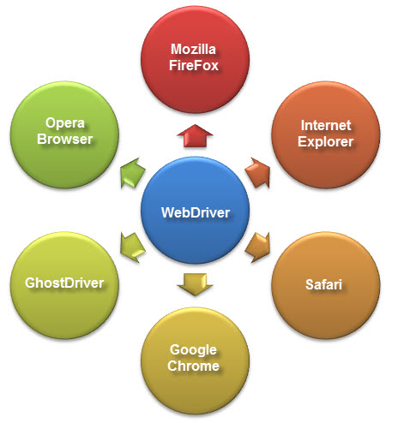
Selenium WebDriver
WebDriver supports multiple browsers.

Slide 6
Selenium WebDriver
RemoteWebDriver
WebDriver
Implements
Extends
Extends
Extends
ChromeDriver
InternetExplorerDriver
FirefoxDriver

Slide 7
Selenium – Web Driver
Syntax
WebDriver driver = new FirefoxDriver()
WebDriver driver = new ChromeDriver()
WebDriver driver = new InternetExplorerDriver()

Slide 8
Selenium – Web Driver - Methods
Method Name | Return Type | Purpose
close() | void | Close the current browser
quit() | void | Quits this driver, closing every associated window
findElement() | WebElement | Find the first WebElement using the given method.
findElements() | List | Find all elements within the current page using the given mechanism.
get() | void | Load a new web page in the current browser window.
getTitle() | String | Returns the title of the page.

Slide 9
WebDriver - Code

Slide 10
ChromeDriver Code
import org.openqa.selenium.WebDriver;
public class ChromeBrowser {
public static void main(String[] args) {
String url = "https://www.myhcl.com/Login/home.aspx";
System.setProperty("webdriver.chrome.driver", "D:\\Selenium\\ChromeServer\\chromedriver.exe");
WebDriver chrome_WD = new ChromeDriver();
chrome_WD.manage().window().maximize();
chrome_WD.get(url);
}
}

Slide 11
FirefoxDriver Code
import org.openqa.selenium.By;
import org.openqa.selenium.WebDriver;
import org.openqa.selenium.WebElement;
import org.openqa.selenium.firefox.FirefoxDriver;
public class FirefoxBrowser {
public static void main(String[] args) {
//TODO Auto-generated method stub
String url = "https://www.myhcl.com/Login/home.aspx";
WebDriver ff_WD = new FirefoxDriver();
ff_WD.get(url);
WebElement element = ff_WD.findElement(By.id("txtUserID"));
element.sendKeys("Sangram");
element = ff_WD.findElement(By.name("txtPassword"));
element.sendKeys("Password");
}
}

Slide 12
InternetExplorerDriver Code
import org.openqa.selenium.WebDriver;
import org.openqa.selenium.ie.InternetExplorerDriver;
public class InternetExplorer {
public static void main(String[] args) {
// TODO Auto-generated method stub
String url = "https://www.myhcl.com/Login/home.aspx";
System.setProperty("webdriver.ie.driver", "D:\\Selenium\\IEServer\\IEDriverServer.exe");
WebDriver IE_WD = new InternetExplorerDriver();
IE_WD.get(url);
String title = IE_WD.getTitle();
System.out.println("Title = " + title);
/*
* Issue which might face while running the this code is org.openqa.selenium.remote.SessionNotFoundException and Browser Zoom Level.
* To resolve it, follow the steps
* 1. Open your Internet Explorer -> Tool -> Internet Option -> Security
* 2. Enable/ Tick the checkbox Enable Protected Mode.
* 3. Select all Zones (Internet, Local Intranet, Trusted Sites, Restricted Sites) and perform Step - 3
* 4. Set IE browser zoom level to 100% (View -> Zoom Level)
*/
}
}

Slide 13
Code
Download the code from https://github.com/sangramkswain/HCLPuneTraining
File Name – Sessions.zip

